Slide 1
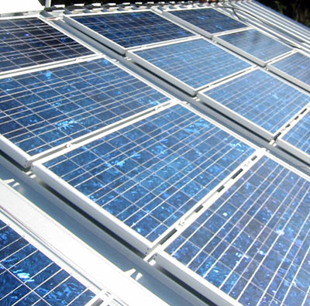
Volkswagen Settlement: Emissions Tools Webinar
National Association of State Energy Officials March 29, 2017

Slide 2
Agenda
Settlement Summary and Recap
NASEO Beneficiary Mitigation Plan Toolkit
AFLEET: Andrew Burnham, Argonne National Laboratory
Diesel Emissions Quantifier: Jeffra Rockwell, U.S. EPA
Shore Power Emission Calculator: Arman Tanman, U.S. EPA
Questions

Slide 3
Settlement Overview
Volkswagen agreed to spend up to $14.7 billion to settle allegations of cheating emissions. Settlement funds will be used to buyback and/or modify vehicles, and to support national- and state-level projects to reduce NOx emissions.
www.naseo.org/volkswagen-settlement

Slide 4
Environmental Mitigation Trust
$2.7 billion will be placed in an Environmental Mitigation Trust, and will be allocated to beneficiaries (states, tribes, and certain territories) based on the number of impacted VW vehicles in their jurisdictions
The Trust will support projects that reduce NOx emissions where the VW vehicles were, are, or will be operated
This table reflects the amount of funds included in the 2.0 liter settlement. An additional $225 million was added to the Environmental Mitigation Trust from the 3.0 liter settlement and allocated to states using the same formula as the 2.0 liter settlement.
Eligible Beneficiary | Initial Allocations |  | Eligible Beneficiary | Initial Allocations |  | Eligible Beneficiary | Initial Allocations
Puerto Rico | $ 7,500,000 |  | Louisiana | $ 18,009,993 |  | Colorado | $ 61,307,576
North Dakota | $ 7,500,000 |  | Kentucky | $ 19,048,080 |  | Wisconsin | $ 63,554,019
Hawaii | $ 7,500,000 |  | Oklahoma | $ 19,086,528 |  | New Jersey | $ 65,328,105
South Dakota | $ 7,500,000 |  | Iowa | $ 20,179,540 |  | Oregon | $ 68,239,143
Alaska | $ 7,500,000 |  | Maine | $ 20,256,436 |  | Massachusetts | $ 69,074,007
Wyoming | $ 7,500,000 |  | Nevada | $ 22,255,715 |  | Maryland | $ 71,045,824
District of Columbia | $ 7,500,000 |  | Alabama | $ 24,084,726 |  | Ohio | $ 71,419,316
Delaware | $ 9,051,682 |  | New Hampshire | $ 29,544,297 |  | North Carolina | $ 87,177,373
Mississippi | $ 9,249,413 |  | South Carolina | $ 21,636,950 |  | Virginia | $ 87,589,313
West Virginia | $ 11,506,842 |  | Utah | $ 32,356,471 |  | Illinois | $ 97,701,053
Nebraska | $ 11,528,812 |  | Indiana | $ 38,920,039 |  | Washington | $ 103,957,041
Montana | $ 11,600,215 |  | Missouri | $ 39,084,815 |  | Pennsylvania | $ 110,740,310
Rhode Island | $ 13,495,136 |  | Tennessee | $ 42,407,793 |  | New York | $ 117,402,744
Arkansas | $ 13,951,016 |  | Minnesota | $ 43,638,119 |  | Florida | $ 152,379,150
Kansas | $ 14,791,372 |  | Connecticut | $ 51,635,237 |  | Texas | $ 191,941,816
Idaho | $ 16,246,892 |  | Arizona | $ 53,013,861 |  | California | $ 381,280,175
New Mexico | $ 16,900,502 |  | Georgia | $ 58,105,433 |  | Tribal Subaccount | $ 49,652,857
Vermont | $ 17,801,277 |  | Michigan | $ 60,329,906 |  | Trust Cost Subaccount | $ 27,000,000
 |  |  |  |  |  | Tribal Cost Subaccount | $ 993,057
 |  |  |  |  |  | Total | $ 2,700,000,000

Slide 5
Environmental Mitigation Trust: Estimated Timeline
VW Environmental Mitigation Trust Timing
Timing | Estimated Date | Consent Decree Milestone
Settlement Effective Date (SED) | October 25, 2016 | Consent Decree entered into court
SED + 30 Days | November 24, 2016 | Trustee candidates submitted
Trust Effective Date (TED) | Spring-Summer, 2017 | Establishment of Environmental Trust
TED + 15 days |  | Trustee established trust account
TED + 60 days |  | Governmental entities file Certification Forms
TED + 120 days (note: proposed consent decree includes the phrase “no later than,” so the Trustee may grant Beneficiary status sooner than 120 days) |  | Trustee approves /denies Beneficiary status
TED + 210 days (not later than 90 days after being deemed a Beneficiary) |  | Beneficiary Mitigation Plan submitted

Slide 6
Environmental Mitigation Trust: Beneficiary Mitigation Plan
After being designated a beneficiary, states must submit a high-level Beneficiary Mitigation Plan that summarizes how the funds will be spent. Plans should address:
Overall goal for the use of the funds;
Categories of anticipated eligible mitigation actions, and preliminary assessment of the percentages of funds anticipated to be used for each type of action;
How the proposed actions will impact air quality in areas that bear a disproportionate share of the air pollution burden within its jurisdiction;
Expected range of emissions benefits.
www.naseo.org/volkswagen-settlement

Slide 7
NASEO’s VW Beneficiary Mitigation Plan Toolkit
Reference for state agencies
Provides overview of the settlement
Highlights plan considerations for beneficiaries
Highlights repower and replacement options, and tools states can use to calculate NOx emissions
Projects must result in NOx reductions. But projects can also help states achieve broader goals, such as:
Greenhouse Gas Emissions Goals and Renewable Portfolio Standards
Fuel Security, Energy Assurance, and Economic Benefits
Health Impacts
Disproportionately Impacted Communities
Alternative fuel vehicles include:
Natural Gas
Propane
Electric
Clean Diesel
Varity of emissions tools available
Summarizes each eligible mitigation action and ranges of expected NOx reductions
Showcases successful implementation of technologies
Authored by NASEO and Vermont Energy Investment Corporation
www.naseo.org/volkswagen-settlement

Slide 8
Example from Toolkit: Eligible Mitigation Action #1 – Eligible Large Trucks
For each action, the Toolkit provides a summary of eligible vehicles;
www.naseo.org/volkswagen-settlement

Slide 9
Example from Toolkit: Eligible Mitigation Action #1 – Eligible Large Trucks
Illustration of the typical emissions impact of repower or replacement of eligible vehicles;
Summary of the percentage of project that can be funded through the trust;
www.naseo.org/volkswagen-settlement

Slide 10
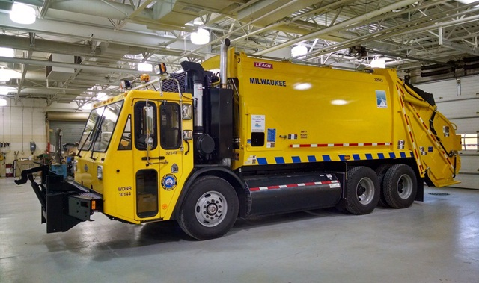
Example from Toolkit: Eligible Mitigation Action #1 – Eligible Large Trucks
Case study highlighting successful implementation of project.
Featured example: Milwaukee used a $750,000 grant to transition their refuse fleet to CNG.
www.naseo.org/volkswagen-settlement

Slide 11
Considerations and Next Steps for States
NASEO Toolkit designed as reference.
Additional steps for states may include:
Consider projects that support longer-term goals, including NOx reduction
Engage stakeholders to understand what projects are local priorities, and how projects may impact disproportionately affected communities
Explore various emissions tools and use resource that is right for your jurisdiction
Examine industry-specific studies to learn about the most recent emissions impacts of various technologies
Talk with your local Clean Cities Coordinators or industry representatives to learn about the most recent technologies and availability in your area
www.naseo.org/volkswagen-settlement

Slide 12
Emissions Tools
AFLEET: Andrew Burnham, Argonne National Laboratory
Diesel Emissions Quantifier: Jeffra Rockwell, U.S. EPA
Shore Power Emission Calculator: Arman Tanman, U.S. EPA
www.naseo.org/volkswagen-settlement

